Slide 1
PowerPoint slides to accompany
System Dynamics, Third Edition
William J. Palm III
Using SimscapeTM for Modeling Thermal Systems:
Dynamics of a Quenching Process
Copyright © 2013. The McGraw-Hill Companies, Inc.

Slide 2
These slides are intended to be used with the author’s text, System Dynamics, 3/e, published by McGraw-Hill©2014.
Acknowledgments
The author wishes to acknowledge the support of McGraw-Hill for hosting these slides, and The MathWorks, Inc., who supplied the software. Naomi Fernandes, Dr. Gerald Brusher, and Steve Miller of MathWorks provided much assistance. Dr. Brusher’s contributions formed the basis for many of the Simscape models presented here.
MATLAB®, Simulink®, and Simscape™ are registered trademarks and trademarks of The MathWorks, Inc. and are used with permission.
The equations and math symbols in these slides were created with the new equation editor in PowerPoint 2010, and thus material containing these elements will appear as graphics when viewed in an earlier version.

Slide 3
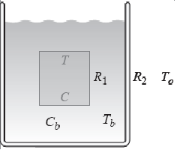
Simscape™ extends the capabilities of Simulink® by providing tools for modeling and simulation of multi-domain physical systems, such as those with mechanical, thermal, hydraulic, and electrical components. In this presentation, we will show you how to utilize Simscape to construct models of thermal processes.
One such process is quenching, whose representation is shown below. We will start with a simple model, in which we assume that the bath temperature T_{b} remains constant. The differential equation model of this case is simple enough to be solved analytically, so we can use the solution to check our Simscape model. Then we will consider the case where T_{b} can vary with time.

Slide 4
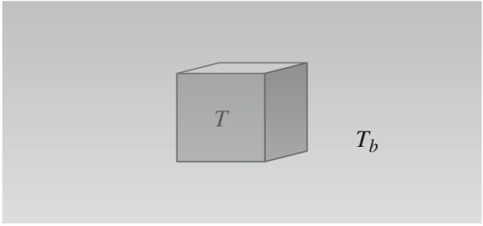
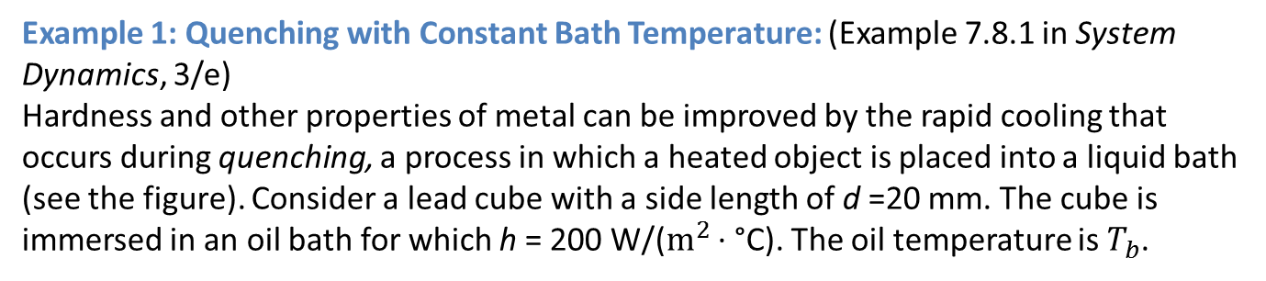
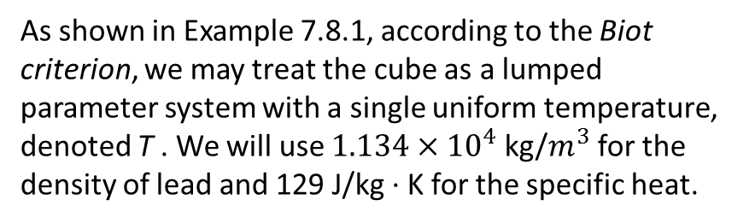
Example 1: Quenching with Constant Bath Temperature: (Example 7.8.1 in System Dynamics, 3/e)
Hardness and other properties of metal can be improved by the rapid cooling that occurs during quenching, a process in which a heated object is placed into a liquid bath (see the figure). Consider a lead cube with a side length of d =20 mm. The cube is immersed in an oil bath for which h = 200 W/($m^{2}$ · °C). The oil temperature is $T_{b}$.
As shown in Example 7.8.1, according to the Biot criterion, we may treat the cube as a lumped parameter system with a single uniform temperature, denoted T . We will use $1.134×{10}^{4}$ kg/$m^{3}$ for the density of lead and 129 J/kg · K for the specific heat.
We want to develop a simulation model to predict the temperature T as a function of time, for a given constant bath temperature $T_{b}$.

Slide 5
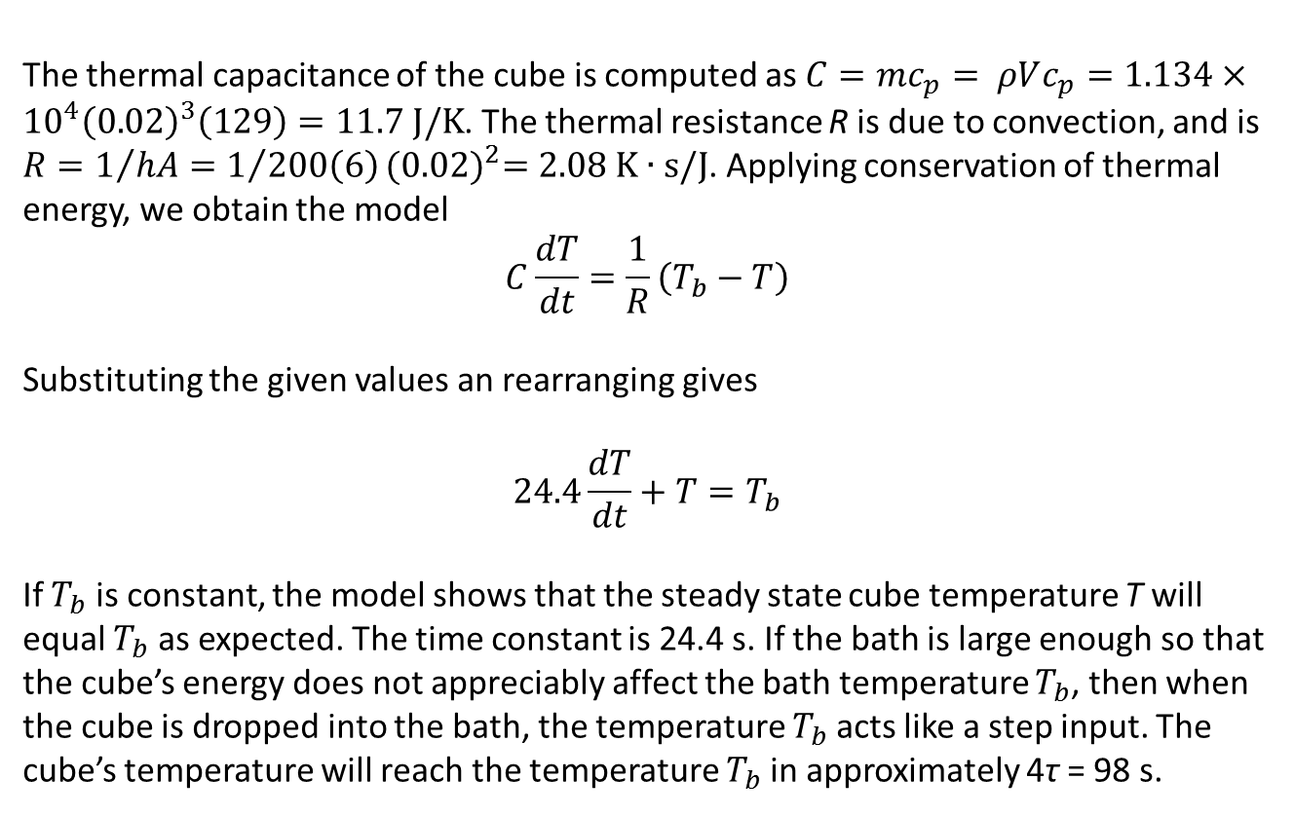
The thermal capacitance of the cube is computed as $C=mc_{p}= ρVc_{p}=1.134×{10}^{4}{\left(0.02\right)}^{3}\left(129\right)=11.7 J/K$. The thermal resistance R is due to convection, and is $R=1/{hA}=1/{200\left(6\right)}{(0.02)}^{2}=2.08 K∙s/J$. Applying conservation of thermal energy, we obtain the model
$$C\frac{dT}{dt}=\frac{1}{R}\left(T_{b}−T\right)$$
Substituting the given values an rearranging gives
$$24.4\frac{dT}{dt}+T=T_{b}$$
If $T_{b}$ is constant, the model shows that the steady state cube temperature T will equal $T_{b}$ as expected. The time constant is 24.4 s. If the bath is large enough so that the cube’s energy does not appreciably affect the bath temperature $T_{b}$, then when the cube is dropped into the bath, the temperature $T_{b}$acts like a step input. The cube’s temperature will reach the temperature $T_{b}$in approximately 4τ = 98 s.

Slide 6
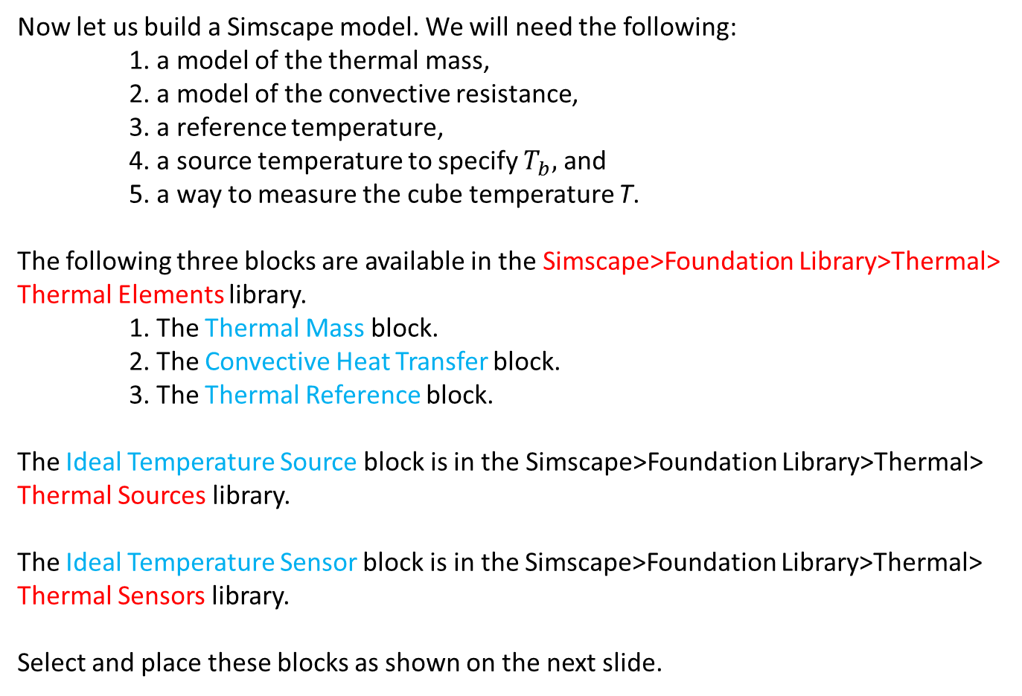
Now let us build a Simscape model. We will need the following:
1. a model of the thermal mass,
2. a model of the convective resistance,
3. a reference temperature,
4. a source temperature to specify $T_{b},$ and
5. a way to measure the cube temperature T.
The following three blocks are available in the Simscape>Foundation Library>Thermal> Thermal Elements library.
1. The Thermal Mass block.
2. The Convective Heat Transfer block.
3. The Thermal Reference block.
The Ideal Temperature Source block is in the Simscape>Foundation Library>Thermal> Thermal Sources library.
The Ideal Temperature Sensor block is in the Simscape>Foundation Library>Thermal> Thermal Sensors library.
Select and place these blocks as shown on the next slide.

Slide 7
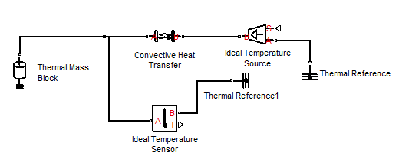
We will discuss these blocks in more detail in the next few slides.

Slide 8
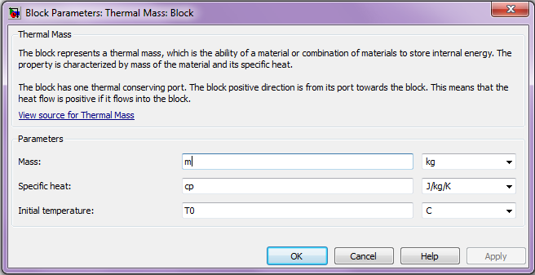
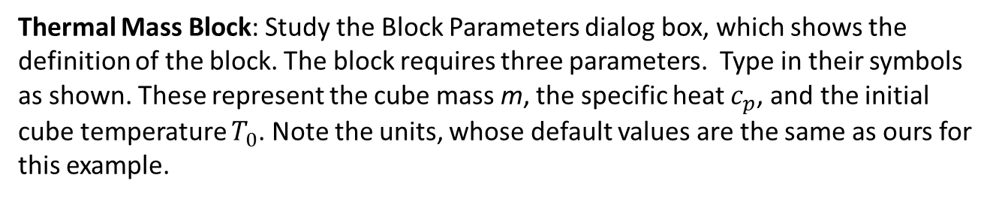
Thermal Mass Block: Study the Block Parameters dialog box, which shows the definition of the block. The block requires three parameters. Type in their symbols as shown. These represent the cube mass m, the specific heat $c_{p}$, and the initial cube temperature $T_{0}$. Note the units, whose default values are the same as ours for this example.
Note that the units of the specific heat are selected as J/kg/K while the initial temperature has units of C. This is reasonable because ΔK = ΔC. Moreover, Simscape internally accounts for differences in units and makes the necessary conversions.

Slide 9
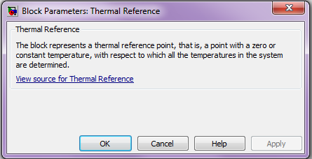
Thermal Reference Block: Its Block Parameters dialog box shows the definition of the block. It requires no parameters.

Slide 10
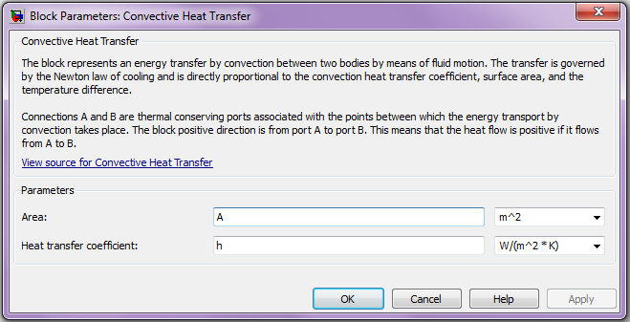
Convective Heat Transfer Block: This models the convective resistance. Study its Block Parameters dialog box, which shows the definition of the block. It requires two parameters. Type in their symbols as shown. These represent the cube surface area A and the heat transfer coefficient h. Note the units, whose default values are the same as ours for this example. Again, we are making use of the fact that ΔK = ΔC.

Slide 11
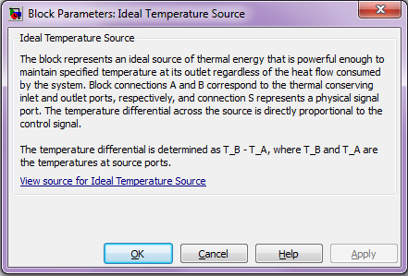
Ideal Temperature Source Block: Its Block Parameters dialog box shows the definition of the block. It requires no parameters.

Slide 12
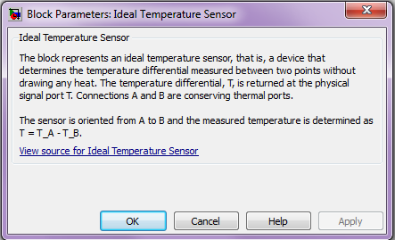
Ideal Temperature Sensor Block: Its Block Parameters dialog box shows the definition of the block. It requires no parameters.

Slide 13
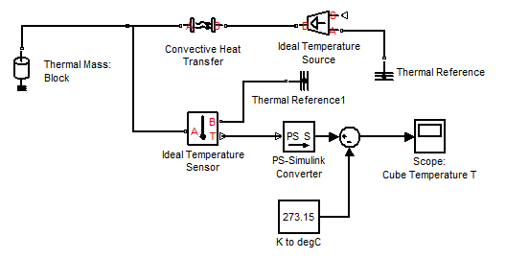
Now insert and connect the PS-Simulink Converter block, which is in the Simscape>Utilities library. Connect its input to the lower output port (T) of the temperature sensor as shown below. This port provides a measurement of the bath temperature T. The B port is connected the Thermal Reference block.
Data from a Simscape model can be further manipulated in Simulink. We will use Simulink to convert the temperature data to degrees C. Insert a Sum block and the Scope. The “K to degC” block is simply a renamed Constant block from the Simulink>Sources library.

Slide 14
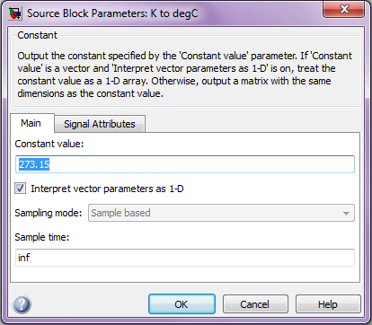
The Block Parameters dialog box of the “K to degC” block is shown below. Enter 273.15 for the value. This is the value of 0°C in degrees K. You create the name of the block as with any other block.

Slide 15
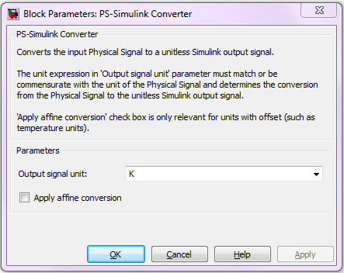
The PS-Simulink Converter block converts the physical signal (PS) to a unit-less Simulink output signal. Its Block Parameters dialog box is shown below. Here the units were selected to be degrees K.
As an alternative to using Simulink to convert the temperature from Kelvin to Celsius, we could have also used this checkbox and then selected Celsius for units.

Slide 16
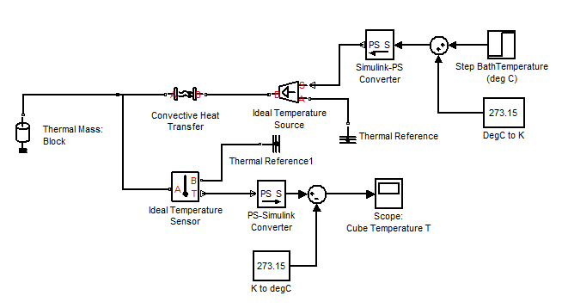
Next select and place the Simulink-PS Converter block from the Simscape>Utilities library and the “DegC to K” block. This is simply a renamed Constant block from the Simulink>Sources library.

Slide 17
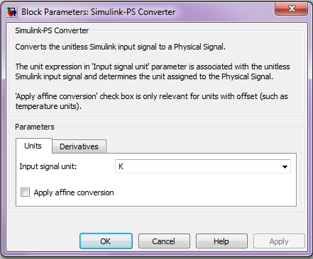
The Simulink-PS Converter block converts a Simulink signal to a physical signal (PS). Its Block Parameters dialog box is shown below. Here the units were selected to be degrees K. Connect its output to port C of the temperature source.

Slide 18
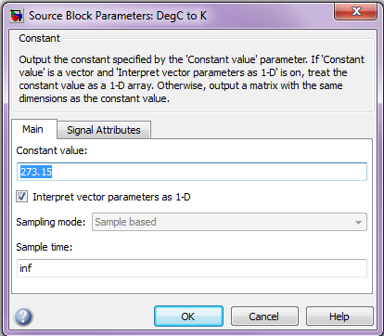
The Block Parameters dialog box of the “degC to K” block is shown below. Enter 273.15 for the value. This is the value of 0°C in degrees K. You create the name of the block as with any other block: by double-clicking and editing the block label.

Slide 19
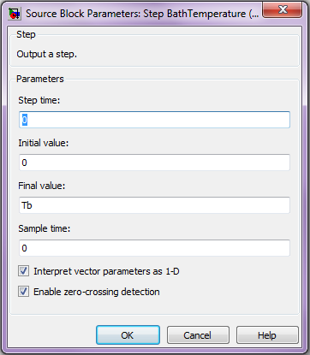

Insert the Sum block and the Step block. Edit the name of the Step block to read as shown. Its Block Parameters dialog box is shown below. Enter 0 for the Step Time and Tb for the Final Value. This describes the bath temperature as step function of magnitude Tb, starting at time $t=0.$

Slide 20
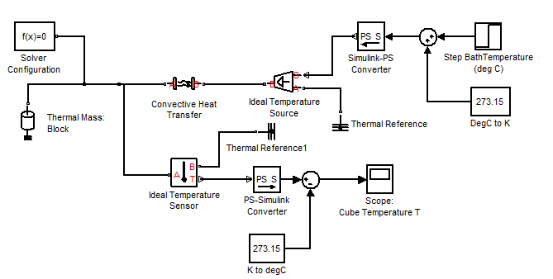
Now complete the model by selecting and placing the Solver Configuration block from the Simscape>Utilities library. Connect it as shown in the figure.

Slide 21
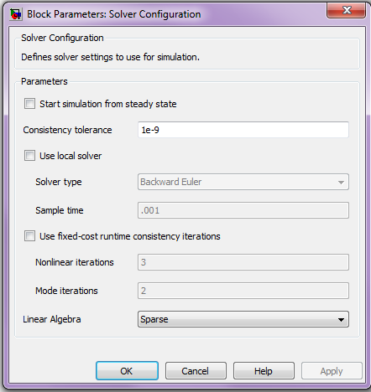
The Solver Configuration block defines the solver settings for this Simscape physical network. The Simulink solver for the entire model must be set separately. Its Block Parameters dialog box is shown below. For this example, do not change any of the parameters in this block (all three boxes should be unchecked).

Slide 22
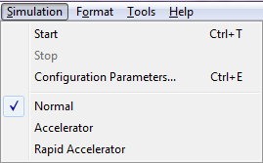
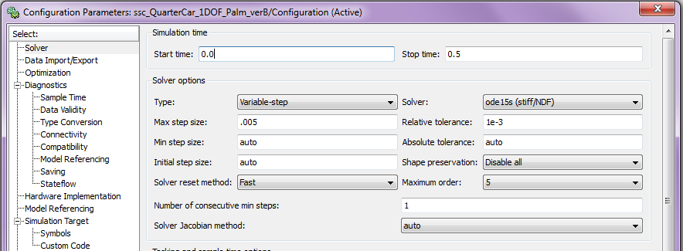
A Note About Solvers: The default solver is ode 45. It is strongly recommended that you change the solver to a stiff solver (ode15s, ode23t, or ode14x). Do this by selecting “Configuration Parameters” from the Simulation menu, selecting the solver pane from the list on the left, and changing the “Solver” parameter to ode15s. Then click OK.

Slide 23
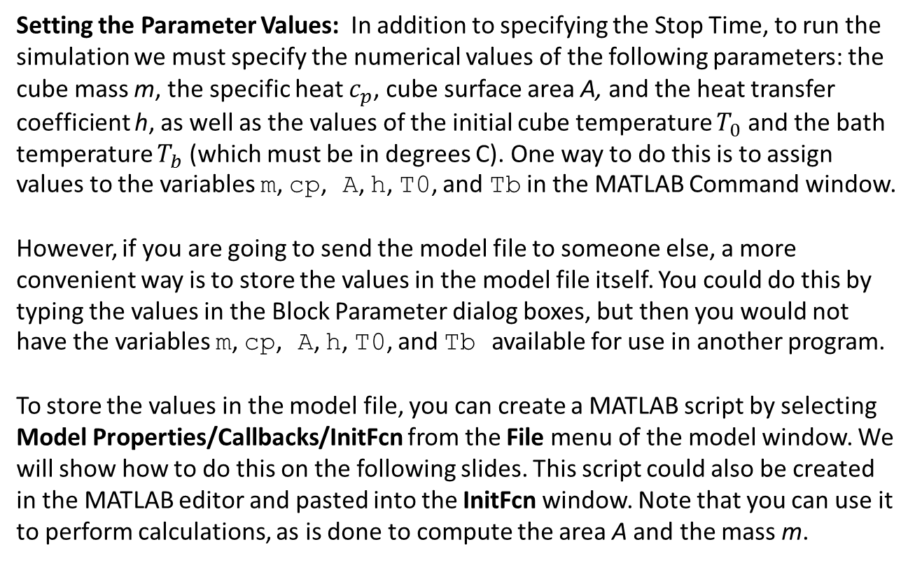
Setting the Parameter Values: In addition to specifying the Stop Time, to run the simulation we must specify the numerical values of the following parameters: the cube mass m, the specific heat $c_{p}$, cube surface area A, and the heat transfer coefficient h, as well as the values of the initial cube temperature $T_{0}$ and the bath temperature $T_{b}$ (which must be in degrees C). One way to do this is to assign values to the variables m, cp, A, h, T0, and Tb in the MATLAB Command window.
However, if you are going to send the model file to someone else, a more convenient way is to store the values in the model file itself. You could do this by typing the values in the Block Parameter dialog boxes, but then you would not have the variables m, cp, A, h, T0, and Tb available for use in another program.
To store the values in the model file, you can create a MATLAB script by selecting Model Properties/Callbacks/InitFcn from the File menu of the model window. We will show how to do this on the following slides. This script could also be created in the MATLAB editor and pasted into the InitFcn window. Note that you can use it to perform calculations, as is done to compute the area A and the mass m.

Slide 24
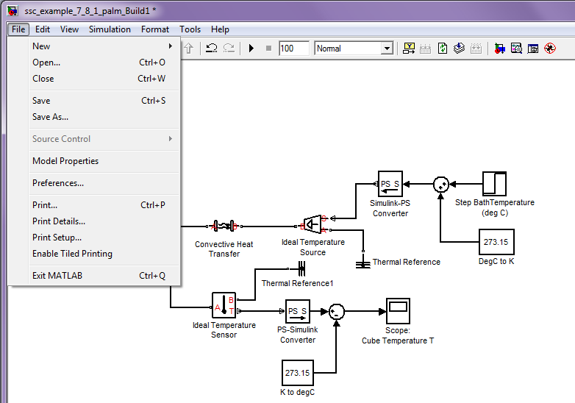
In the Simulink model window, select Model Properties from the File menu:

Slide 25
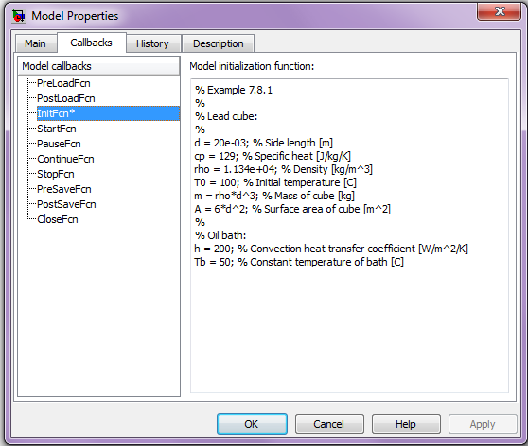
This will bring up the Model Properties dialog box. Select the Callbacks tab.
Select InitFcn from the list of Model callbacks. Then, type MATLAB® commands into the pane under Model initialization function. These commands will execute at the start of model simulation. Note that an asterisk will appear next to a callback function that has commands written into it.
Type MATLAB commands here.
You then type in the commands shown on the next slide. This script could also be created in the MATLAB editor and pasted into the InitFcn window.

Slide 26
Type the following commands in the InitFcn window:
% Example 7.8.1
%
% Lead cube:
%
d = 20e-03; % Side length [m]
cp = 129; % Specific heat [J/kg/K]
rho = 1.134e+04; % Density [kg/m^3]
T0 = 100; % Initial temperature [C]
m = rho*d^3; % Mass of cube [kg]
A = 6*d^2; % Surface area of cube [m^2]
%
% Oil bath:
h = 200; % Convection heat transfer coefficient [W/m^2/K]
Tb = 50; % Constant temperature of bath [C]

Slide 27
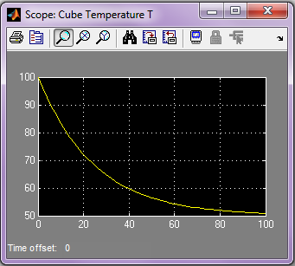
Now set the Stop Time to 100 and run the program. You should see the following in the Scope display. The cube temperature decays to nearly the bath temperature in about the 98 s predicted by the differential equation model.

Slide 28
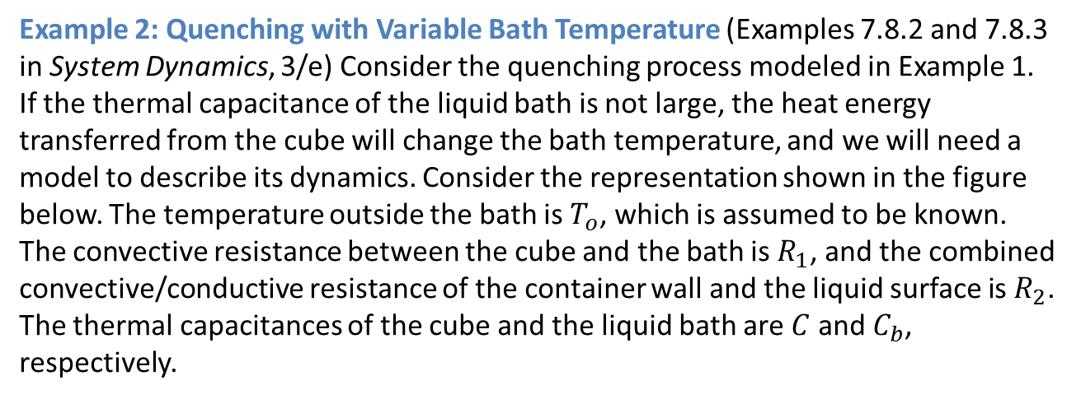
Example 2: Quenching with Variable Bath Temperature (Examples 7.8.2 and 7.8.3 in System Dynamics, 3/e) Consider the quenching process modeled in Example 1. If the thermal capacitance of the liquid bath is not large, the heat energy transferred from the cube will change the bath temperature, and we will need a model to describe its dynamics. Consider the representation shown in the figure below. The temperature outside the bath is $T_{o}$, which is assumed to be known. The convective resistance between the cube and the bath is $R_{1}$, and the combined convective/conductive resistance of the container wall and the liquid surface is $R_{2}$. The thermal capacitances of the cube and the liquid bath are $C$ and $C_{b}$, respectively.

Slide 29
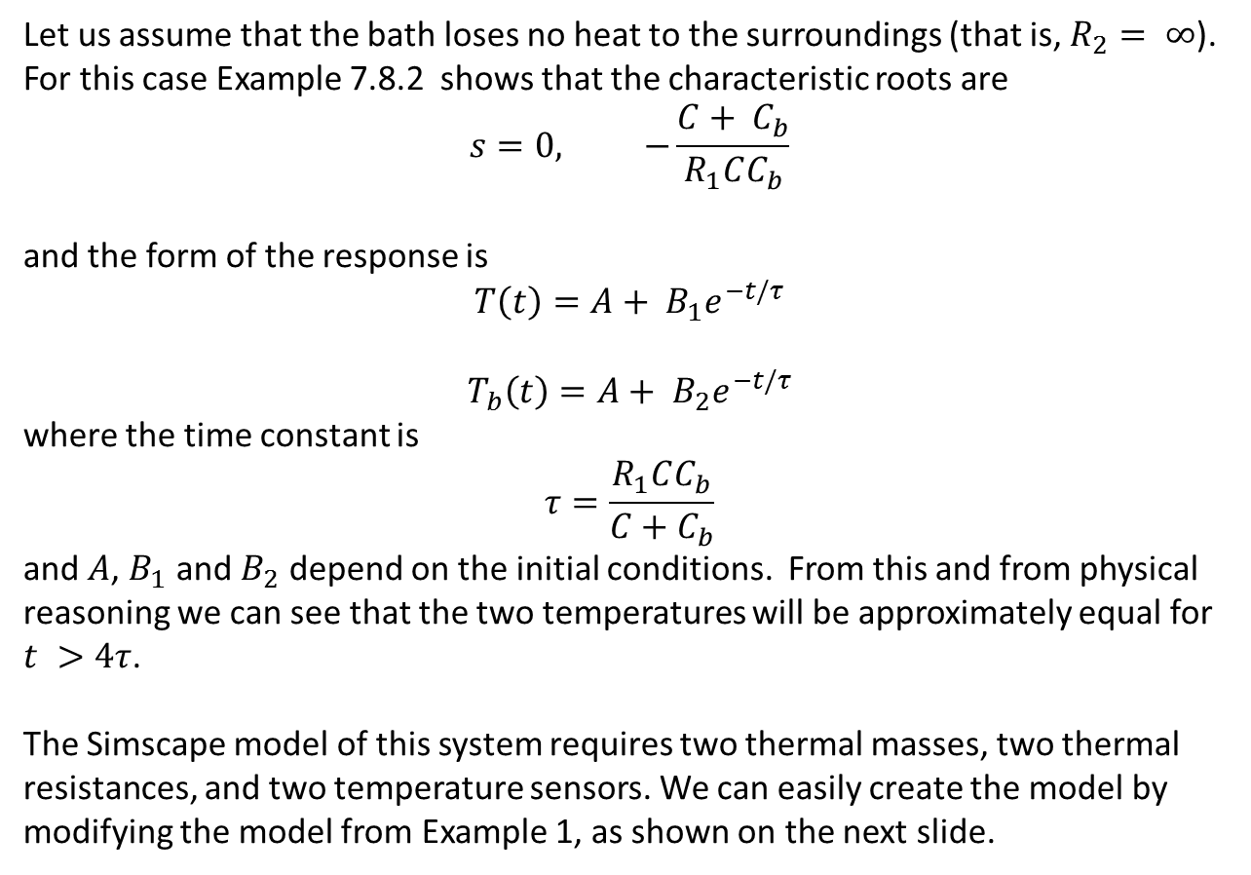
Let us assume that the bath loses no heat to the surroundings (that is, $R_{2}= ∞$). For this case Example 7.8.2 shows that the characteristic roots are
$$s=0, −\frac{C+ C_{b}}{R_{1}CC_{b}}$$
and the form of the response is
$$T\left(t\right)=A+ B_{1}e^{−t/τ}$$
$$T_{b}\left(t\right)=A+ B_{2}e^{−t/τ}$$
where the time constant is
$$τ=\frac{R_{1}CC_{b}}{C+C_{b}}$$
and $A$, $B_{1}$ and $B_{2}$ depend on the initial conditions. From this and from physical reasoning we can see that the two temperatures will be approximately equal for $t >4τ$.
The Simscape model of this system requires two thermal masses, two thermal resistances, and two temperature sensors. We can easily create the model by modifying the model from Example 1, as shown on the next slide.

Slide 30
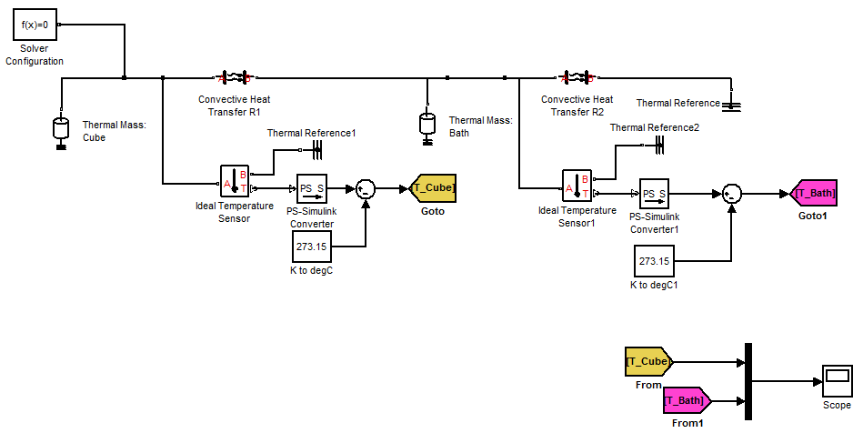
The new blocks here are the Goto and From blocks, which are in the Simulink>Signal Routing library. They can be used to simplify the connections in a complex model diagram. They are discussed on the next two slides.

Slide 31
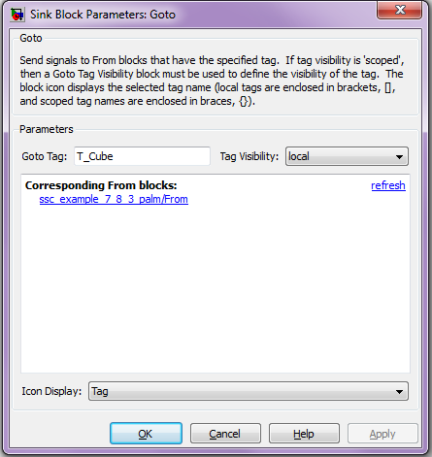
The Block Parameters dialog box for the Goto block is shown below. After placing the block, in the Goto Tag dialog box you type in a descriptive name, here T_Cube to indicate that the cube temperature is to be passed to a corresponding From block in another part of the diagram.

Slide 32
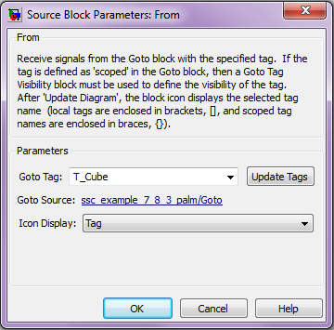
The Block Parameters dialog box for the From block is shown below. After placing the block, in the Goto Tag dialog box you type in the same descriptive name corresponding to a Goto block (or simply select the previously defined name from the Goto Tag drop-down menu), here T_Cube. This indicates that the cube temperature is obtained from the corresponding Goto block in another part of the diagram.
Goto Tag drop-down menu.

Slide 33
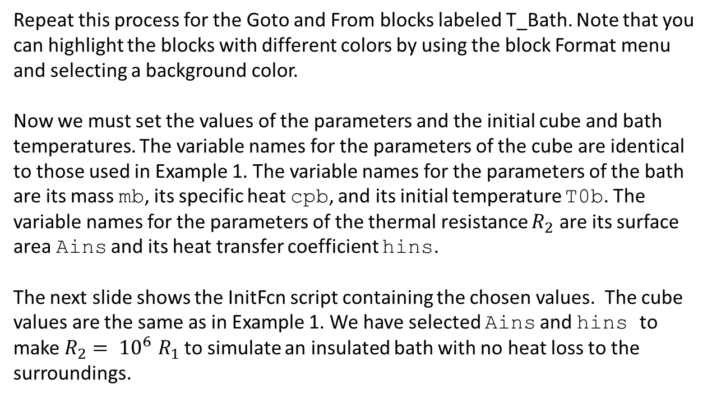
Repeat this process for the Goto and From blocks labeled T_Bath. Note that you can highlight the blocks with different colors by using the block Format menu and selecting a background color.
Now we must set the values of the parameters and the initial cube and bath temperatures. The variable names for the parameters of the cube are identical to those used in Example 1. The variable names for the parameters of the bath are its mass mb, its specific heat cpb, and its initial temperature T0b. The variable names for the parameters of the thermal resistance $R_{2}$ are its surface area Ains and its heat transfer coefficient hins.
The next slide shows the InitFcn script containing the chosen values. The cube values are the same as in Example 1. We have selected Ains and hins to make $R_{2}$ ${= 10}^{6}R_{1}$ to simulate an insulated bath with no heat loss to the surroundings.

Slide 34
% InitFcn script for Example 7.8.3
% Lead cube:
d = 20e-03; % Side length [m]
cp = 129; % Specific heat [J/kg/K]
rho = 1.134e+04; % Density [kg/m^3]
T0 = 100; % Initial temperature [C]
m = rho*d^3; % Mass of cube [kg]
A = 6*d^2; % Surface area of cube [m^2]
% Oil bath:
h = 200; % Convection heat transfer coefficient [W/m^2/K]
T0b = 50; % Constant temperature of bath [C]
cpb = 1800; % Specific heat of light oil (J/kg/K)
rho_b = 0.9e+03; % Density [kg/m^3]
vol_ratio = 10; % Bath volume to cube volume
Vb = vol_ratio * d^3; % Volume of bath liquid [m^3]
mb = Vb * rho_b; % Mass of bath liquid [kg]
% Insulation between bath and surroundings
Ains = A*1e-03; hins = h*1e-03;
% Note: Rins = 1/(Ains*hins)
% Note: these values simulate a large R2(=R1*1e+6)

Slide 35
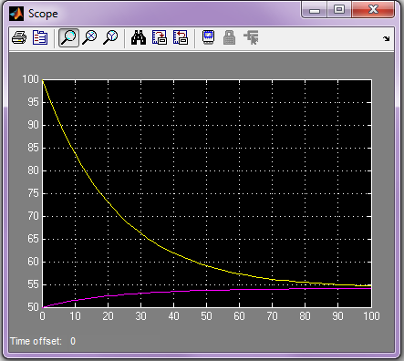
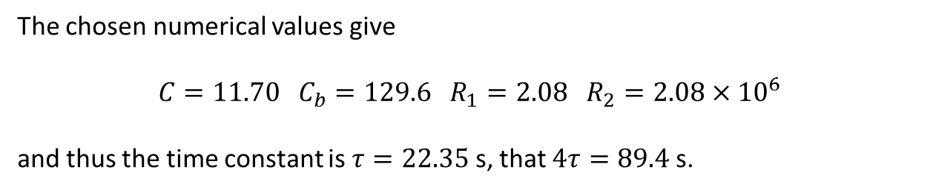
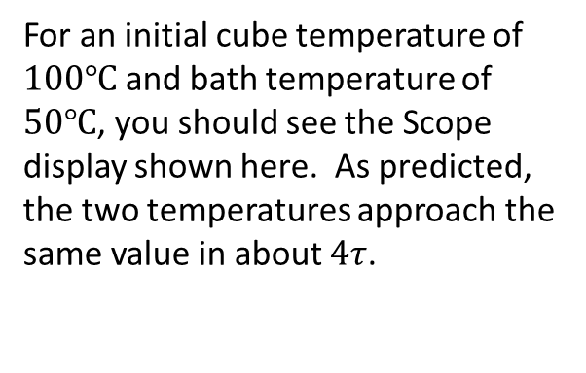
The chosen numerical values give
$$C=11.70 C_{b}=129.6 R_{1}=2.08 R_{2}=2.08×{10}^{6}$$
and thus the time constant is $τ=22.35$ s, that $4τ=89.4$ s.
For an initial cube temperature of $100℃$ and bath temperature of $50℃$, you should see the Scope display shown here. As predicted, the two temperatures approach the same value in about $4τ$.

Slide 36
This completes our introduction to thermal system modeling with Simscape. There are other elements in the Thermal library that we have not used. The Thermal Elements library contains the Conductive Heat Transfer block and the Radiative Heat Transfer block. The Thermal Sensors library contains the Ideal Heat Flow Sensor block. The Thermal Sources library contains the Ideal Heat Flow Source block.
Finally, we point out that you can add text to the Simulink model, as we have done on the next slide. Double-click on the desired location and then enter the text. Use the Format menu to select the foreground and background colors. The title describes the simulation, and a text block alerts the user to the fact that the parameter values are stored in the InitFcn file.

Slide 37
